Slide 1
Introduction to Wireless Sensor Networks
Sensinode, Mikko Saarnivala
Course feedback
Closing the projects

Slide 2
Give Course feedback (Oiva)
And then you are free to go….
Thanks for the course!

Slide 3
Cource feedback (alone or 2-3 persons groups)
Content: Good and not so good points
Instructor: Good and not so good poi

Slide 4
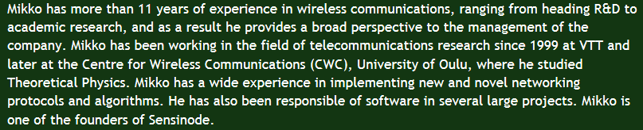
Sensinode
Mikko Saarnivala, Chief Technology Officer

Slide 5
Questions for Mikko
Company related questions:
Are there any job positions available?
Why did you stop making hardware?
What is exactly your product
Why nano term in all of your products?
What are your main competitors? How do they differ from Sensinode?
How many people are working at the moment?
What are you major customers?
Does Sensinode have office in Asia? (how you are giving technical support to the area?)
Notes:
Many other comparies are also implementing zigbee IP protocol stack. How well Sensinode is doing compared to others?
When one can buy a zigbee IP radio chip and Zigbee IP protocol? How much such a chip and software costs?
How big is Sensinode company (people and money vise)
6LoWPAN => Anyting other than Zigbee IP coming?

Slide 6
Questions for Mikko
Technology related questions:
How does nanostack differ from other WSN stack?
What is your licencing model? Are there any rojalties per product or…?
How long does it take until Zigbee IP is coming?
What is the next step for wireless technology?
How is NanoService platform used in healtcare?
Is the Zigbee IP the winning standard or is there competiors for it?
What are the main criterias for choosing Zigbee IP wireless technology?
Notes:
Many other comparies are also implementing zigbee IP protocol stack. How well Sensinode is doing compared to others?
When one can buy a zigbee IP radio chip and Zigbee IP protocol? How much such a chip and software costs?
How big is Sensinode company (people and money vise)
6LoWPAN => Anyting other than Zigbee IP coming?

Slide 7
Closing the projects
Matrix multimedia project groups (materials from Optima):
Using 4 nodes (1,2,3 and 4) learn first what the given software does.
Using Zena network analyser monitor messages to verity that SW actually works like you analyzed in the first step. (Remember to allocate own PAN ID and channel for each group)
Ultimate goal is to make a MESH network where message from node 3 is going through router (node 4) to node 2. In order to achieve this you can modify SW.

Slide 8
Closing the projects
Arduino+Xbee groups:
Terminal to terminal communication via 2 X-CTU+Arduino+Xbee. Document the Xbee firmware version and configuration.
Arduino+Xbee ⬄Xbee wireless communication. Wireless door bell or wireless voltage sensor application (i.e. using Xbee A/D or input/output pins).

Slide 9
Project evaluation
How independently a group has done the ”project” (0-2p)
What are the results and how challenging work has been done (0-3p)
How the group presents its results (0-1p)
Above points are discussed and agreed with the group on Monday 29.4.

Slide 10
Things to explain first…
Xbee radio chip
ZENA protocol analyzer
Flowcode
  Commands (loop, ouput, = function, comp-macro)
  Devices and their parameters.
  How to compile and explore C-code
  Let’s try to remember that radio chip is Xbee

Slide 11
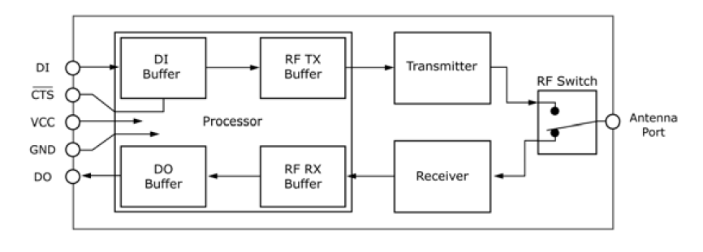
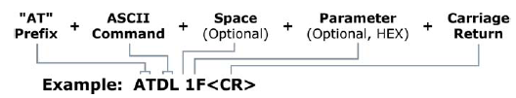
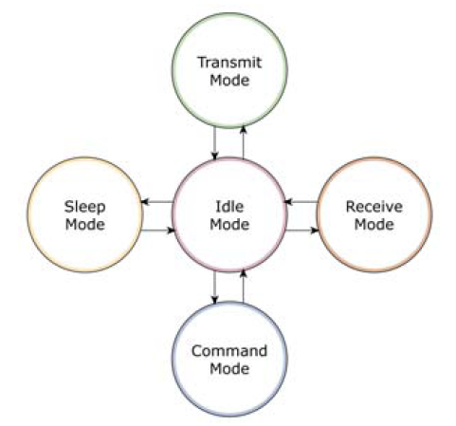
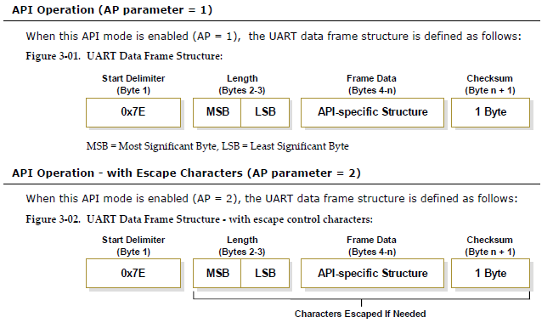

Slide 12
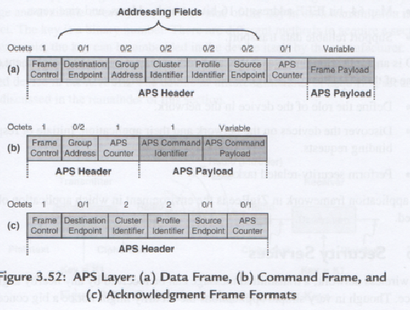
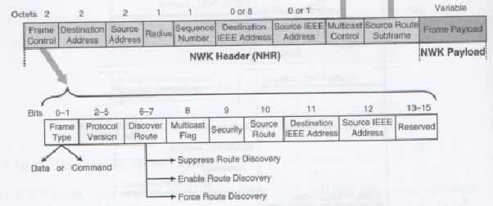
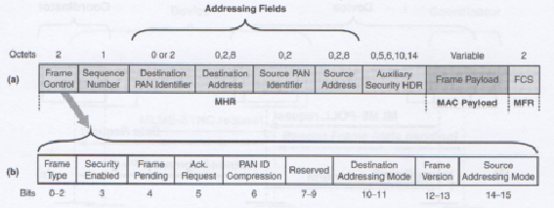
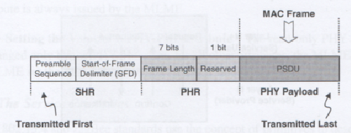

Slide 13
Step 1
Read Xbee product manual document and find following information:
Which 2 API modes the chip has?
What are the 5 modes the chip can be in?
Chip AT commands are divided to 8 categories. What are those and explain shortly what is the purpose of each category?
Short explanation what can you do with the chip?
Notes:
Special to write to non-volatile memory, restore settings and to reset the device.
Networking&security to control addresses, coordinator and end device settings, scan and assosiation parameters.
RF interfacing to adjust power level and threshold for CCA energy
Sleep (low power) to control sleep times and modes.
Serial interfacing to control interface datarate
I/O settings to control pins (AD/I/O, PWM)
Diagnostics to read HW and SW versions and to observe RSSI, ACK, CCA and ED success.
AT command mode options to modify entering and exiting the command mode.

Slide 14
Step2
Get familar with Matrix Multimedia Zigbee functions (node1.c):
Following functions are mostly used:
static char FCD_Zigbee0_Get_AT_Response(char logging)
static void FCD_Zigbee0_Send_AT_Command(char* String, char MSZ_String)
static char FCD_Zigbee0_Receive_Char(char nTimeout)
static void FCD_Zigbee0_Send_Char(char nChar)
static char FCD_Zigbee0_Connect_To_Name(char* String, char MSZ_String)
static char FCD_Zigbee0_Connect_To_Coordinator()
static char FCD_Zigbee0_Connect_To_All()
static char FCD_Zigbee0_Scan_Network(char mode)
static void FCD_Zigbee0_Init_Network()
Explain what those functions do. What they take as input parameter and what are their return parameters.

Slide 15
Step 3
Groups get 2 flowcode software examples (Setting up an network with 2 devices and 4 device network. Exercise 2 and 3 from red booklet.)
Try to understand first what the 2 examples given actually do and learn at the same time how flowcode works.
Learn to use ZENA analyzer to monitor network messages.

Slide 16
Step 4
Select a sensor, desing and develop your own sensor network application.
If you want more than 4 devides to your application, necotiate with other groups for joint effort.
There is at least 1 TCP/IP module which can be connected to make a border router to internet.

